Slide 1







Deep Learning with Keras with TensorFlow

Slide 2
Autoencoders

Slide 3

By the end of this lesson, you will be able to:
Explore autoencoders and their functionalities
Create autoencoder model to detect anomalies

Slide 4


Unsupervised Learning
Unsupervised learning is to learn the structure of the data and correlations between features from input data with no labels. For example, clustering, compression, feature and representation learning, dimensionality reduction, generative models, etc.

Slide 5
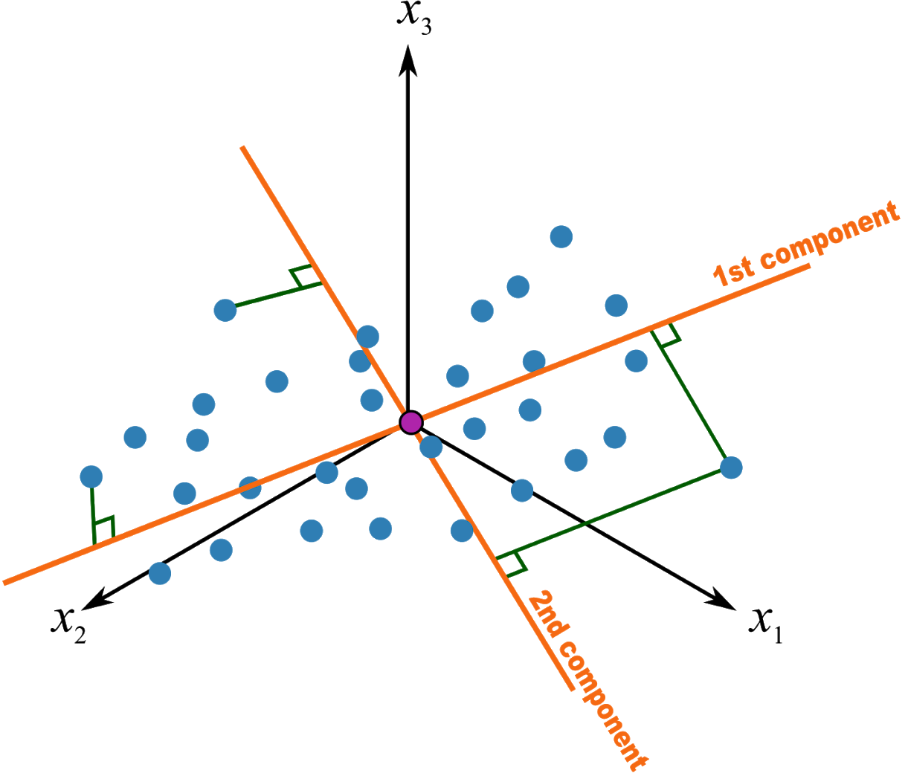

Principal Component Analysis (PCA)
Invented by Karl Pearson in 1901
Is a statistical approach for data compression and visualization
Has a drawback as it analyzes linear components only

Slide 6
Autoencoders
An autoencoder is a type of artificial neural network used to learn efficient data codings in an unsupervised manner.
Kramer, Mark A. (1991). "Nonlinear principal component analysis using auto associative neural networks"
Notes:
Kramer, Mark A. (1991). "Nonlinear principal component analysis using auto associative neural networks"

Slide 7
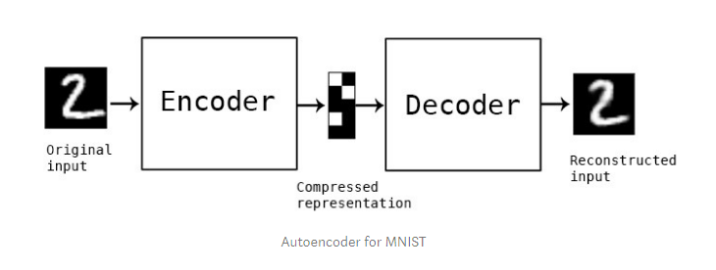
Autoencoder: Example
Learning the identity function seems trivial, but with added constraints on the network (such as limiting the number of hidden neurons or regularization) we can learn information about the structure of the data.
Trying to capture the distribution of the data

Slide 8
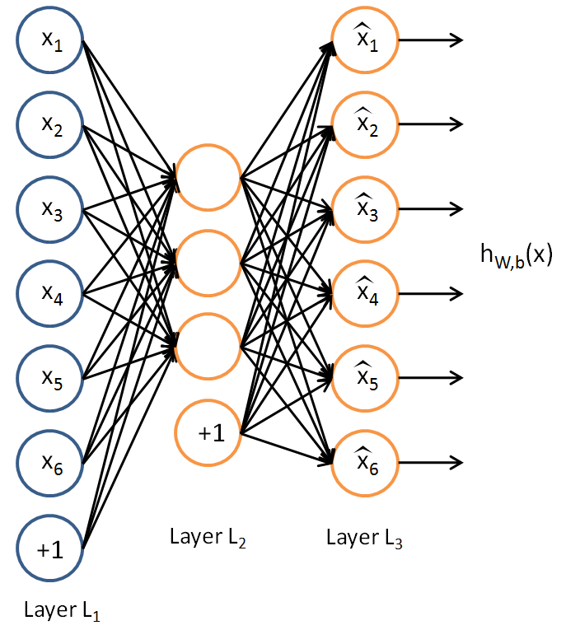
Autoencoders
Analyzes nonlinear components unlike PCA
Achieves the PCA capacity even without activation functions

Slide 9
Uses of Autoencoders
Dimensionality Reduction
Image Denoising
Anomaly Detection
Feature Learning
Cloud Partners

Slide 10
Components of an Autoencoder
Encoder
Reduces the input dimensions and compresses the input data into an encoded representation
Learning the identity function seems trivial, but with added constraints on the network (such as limiting the number of hidden neurons or regularization) we can learn information about the structure of the data.
Bottleneck
Contains the compressed representation of the input data in its lowest possible form
Decoder
Reconstructs the data from the encoded representation to the original as same as possible
Reconstruction Loss
Measures the performance of the decoder and the similarities between the input and the output
Trying to capture the distribution of the data

Slide 11
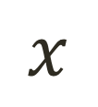
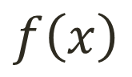
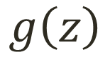
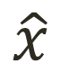
Autoencoder Formulation

Slide 12
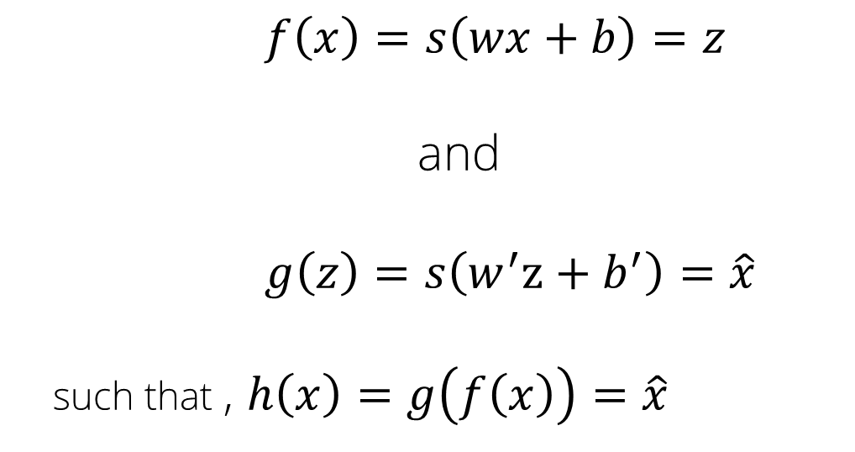
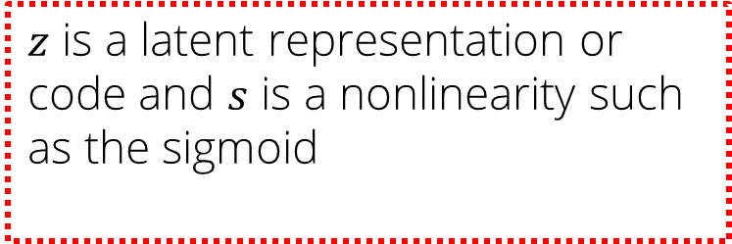
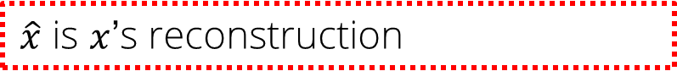
Autoencoder Formulation
ℎ is an approximation of the identity function.

Slide 13
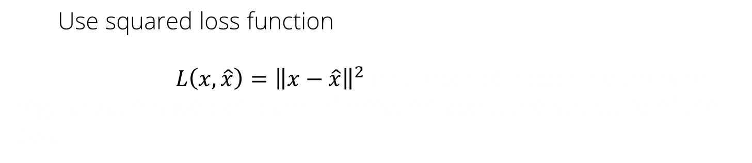
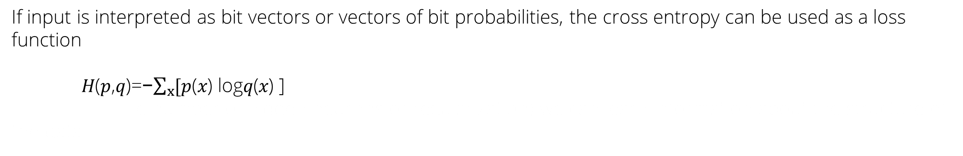
Training an Autoencoder
To train the model, gradient descent is used
Trying to capture the distribution of the data

Slide 14
Types of Autoencoder
Undercomplete AE
Overcomplete AE
Trying to capture the distribution of the data

Slide 15


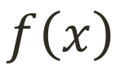

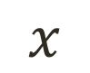
Undercomplete AE
If hidden layer is smaller than input layer, it is undercomplete.
Compresses the input
Compresses well only for the training distribution
e number of hidden neurons or regularization) we can learn information about the structure of the data.
Hidden nodes are:
Good features for the training distribution
Bad for other types of features on the input data
e number of hidden neurons or regularization) we can learn information about the structure of the data.
Trying to capture the distribution of the data

Slide 16


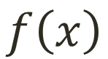
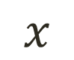

Overcomplete AE
Hidden layer is overcomplete, if greater than the input layer
No compression in hidden layer
Each hidden unit could copy a different input component
Adding dimensions is good for training a linear classifier
the structure of the data.
A higher dimension code helps model a more complex distribution
the structure of the data.
Trying to capture the distribution of the data

Slide 17
What Is Anomaly Detection?
Anomaly detection is the identification of rare items, events, or observations which raise suspicions by differing significantly from the majority of the data.

Slide 18
Build an Autoencoder Model
Problem Statement: Build an autoencoder model to regenerate the objects of the given MNIST dataset.
Objective: Regenerate the objects of MNIST dataset using autoencoder model.
Access: Click the Practice Labs tab on the left panel. Now, click on the START LAB button and wait while the lab prepares itself. Then, click on the LAUNCH LAB button. A full-fledged jupyter lab opens, which you can use for your hands-on practice and projects.

Slide 19
Now, you are able to:
Explore autoencoders and their functionalities
Create autoencoder model to detect anomalies

Slide 21
Which of the following model categories does an autoencoder fall into?
1
Supervised
Unsupervised
Semi-Supervised
None of the above

Slide 22
Which of the following model categories does an autoencoder fall into?
1
Supervised
Unsupervised
Semi-Supervised
None of the above
b
An autoencoder falls under the category of unsupervised model.

Slide 23
Which of the following components are the parts of an autoencoder?
2
Encoder
Decoder
Coder
All of the above

Slide 24
Which of the following components are the parts of an autoencoder?
2
Encoder
Decoder
Coder
All of the above
d
Encoder, coder, and decoder all are parts of an autoencoder.

Slide 25
Which of the following parts of an autoencoder compresses input into latent sparse representation?
3
Encoder
Decoder
Coder
None of the above

Slide 26
Which of the following part of an autoencoder compresses input into latent sparse representation?
3
Encoder
Decoder
Coder
None of the above
a
Encoder compresses input into latent sparse representation.

Slide 27
Which of the following falls into generative model category?
4
PCA
Autoencoder
Vibrational Autoencoder
None of the above

Slide 28
Which of the following falls into generative model category?
4
PCA
Autoencoder
Vibrational Autoencoder
None of the above
C
Variational Autoencoder falls into the generative model category.

Slide 29
Anomaly Detection in Credit Card Transactions
Problem Statement: Build an autoencoder model to detect fraudulent credit card transactions for the given data set.
Objective: Use Keras deep learning framework to build the autoencoder model to detect anomalies in credit card transactions.
Access: Click the Practice Labs tab on the left panel. Now, click on the START LAB button and wait while the lab prepares itself. Then, click on the LAUNCH LAB button. A full-fledged jupyter lab opens, which you can use for your hands-on practice and projects.

